Slide 1
Convolutional neural network identification of galaxy post-mergers in UNIONS using IllustrisTNG
CNN
Canada-France Imaging Survey (CFIS)
...
A Hydrodynamical Simulation of Galaxy Formation
arXiv:2103.09367 by Robert W. Bickley et. al.
Yangyao Chen, 2021/03/22 @ UMass

Slide 2
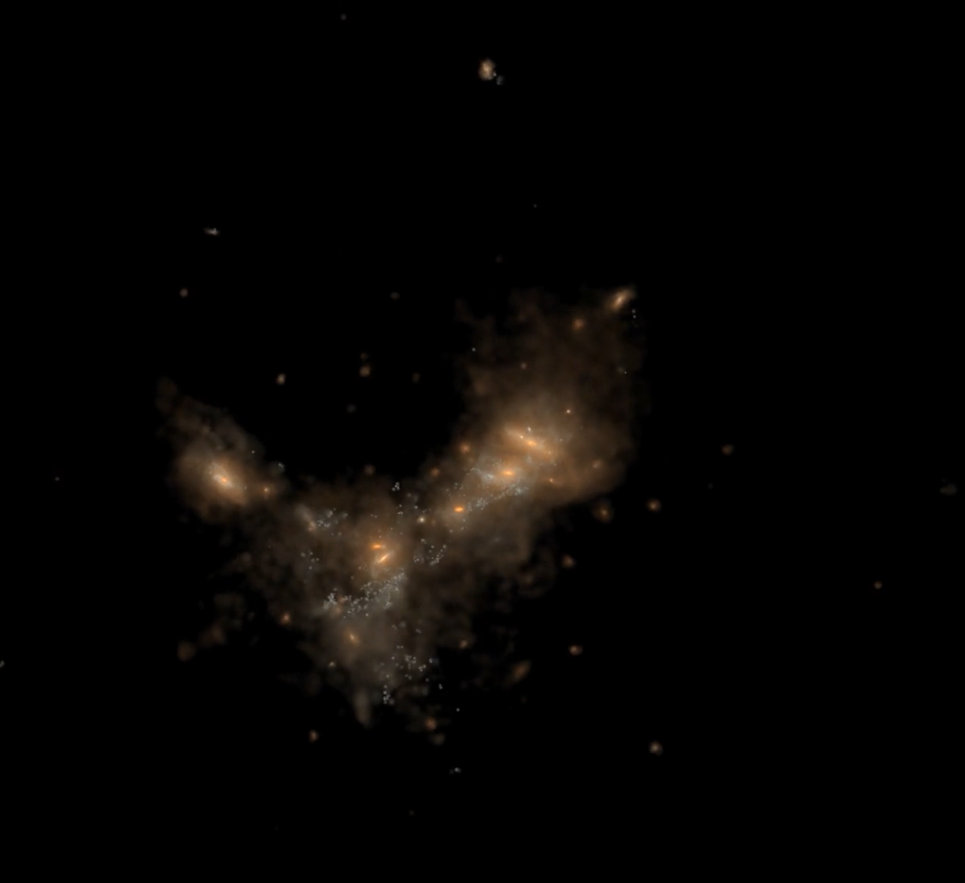
Galaxy Mergers and Galaxy Formation
Mergers alter the evolutionary trajectories of galaxies.
Starburst induced by merger.
SMBH and AGN formation.
Outflow of the galaxy which enriches the IGM.
Formation of elliptical galaxies.
https://www.tng-project.org/media/

Slide 3
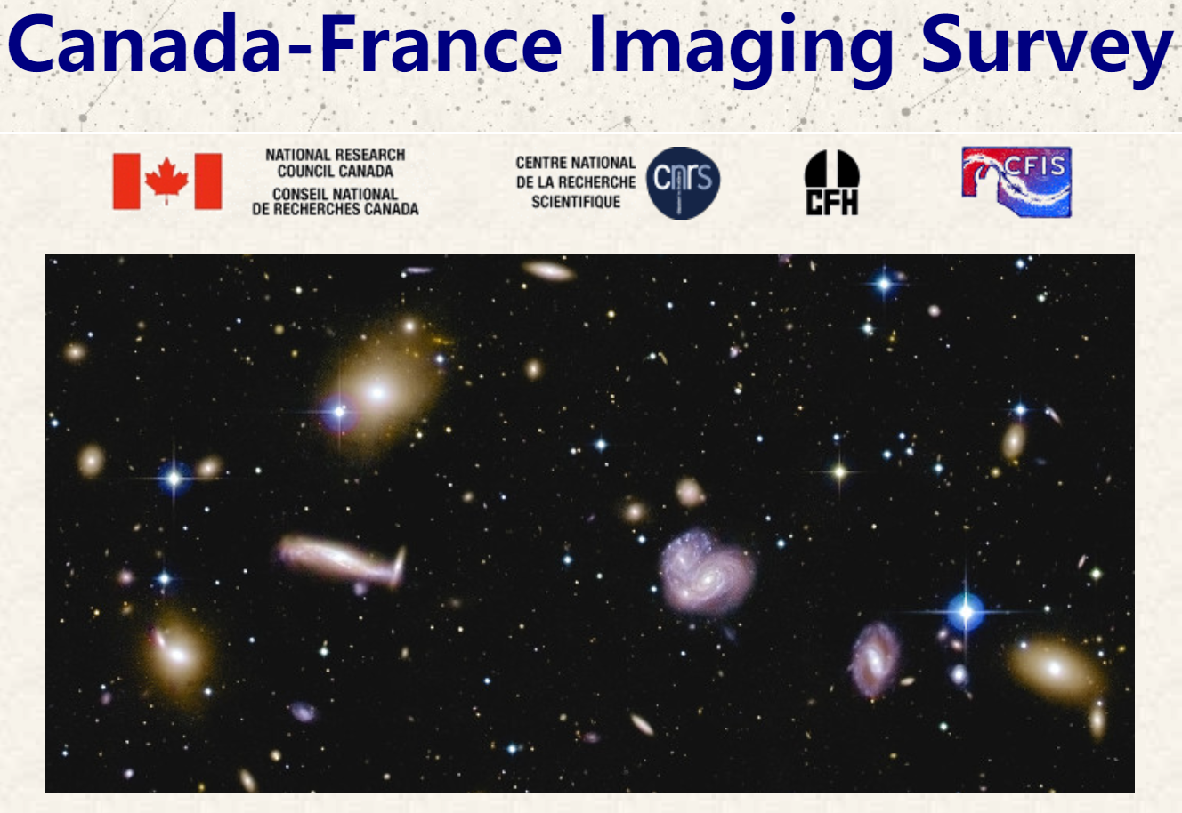
CFIS Survey
r-band imaging ($\sim 0.6$ arcsec seeing) for > 100000 galaxies.
> 5000 $\deg^{2}$, $\sim 3300$ overlapped with SDSS/BOSS.
25.85 mag depth.
likely to contains thousands of post-mergers.
https://www.cfht.hawaii.edu/Science/CFIS/

Slide 4
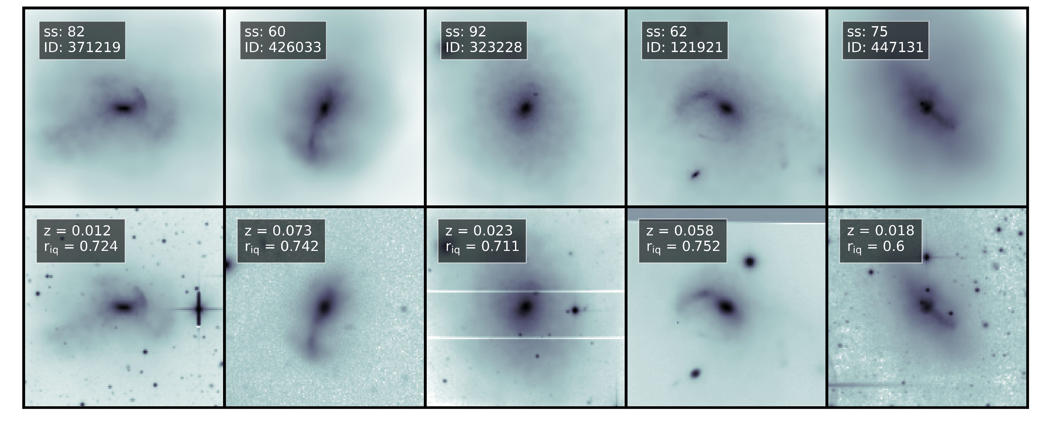
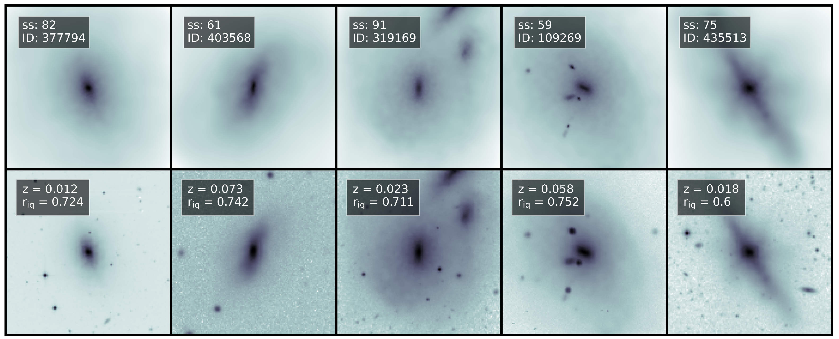
TNG stellar map
Image synthesis
Synthetic image
$z_{obs}$ assignment using real CFIS distribution.
Redshift dimming.
Image rebinning.
PSF.
Add real SDSS as background.
Post-mergers
TNG stellar map
Synthetic image
Control galaxies

Slide 5
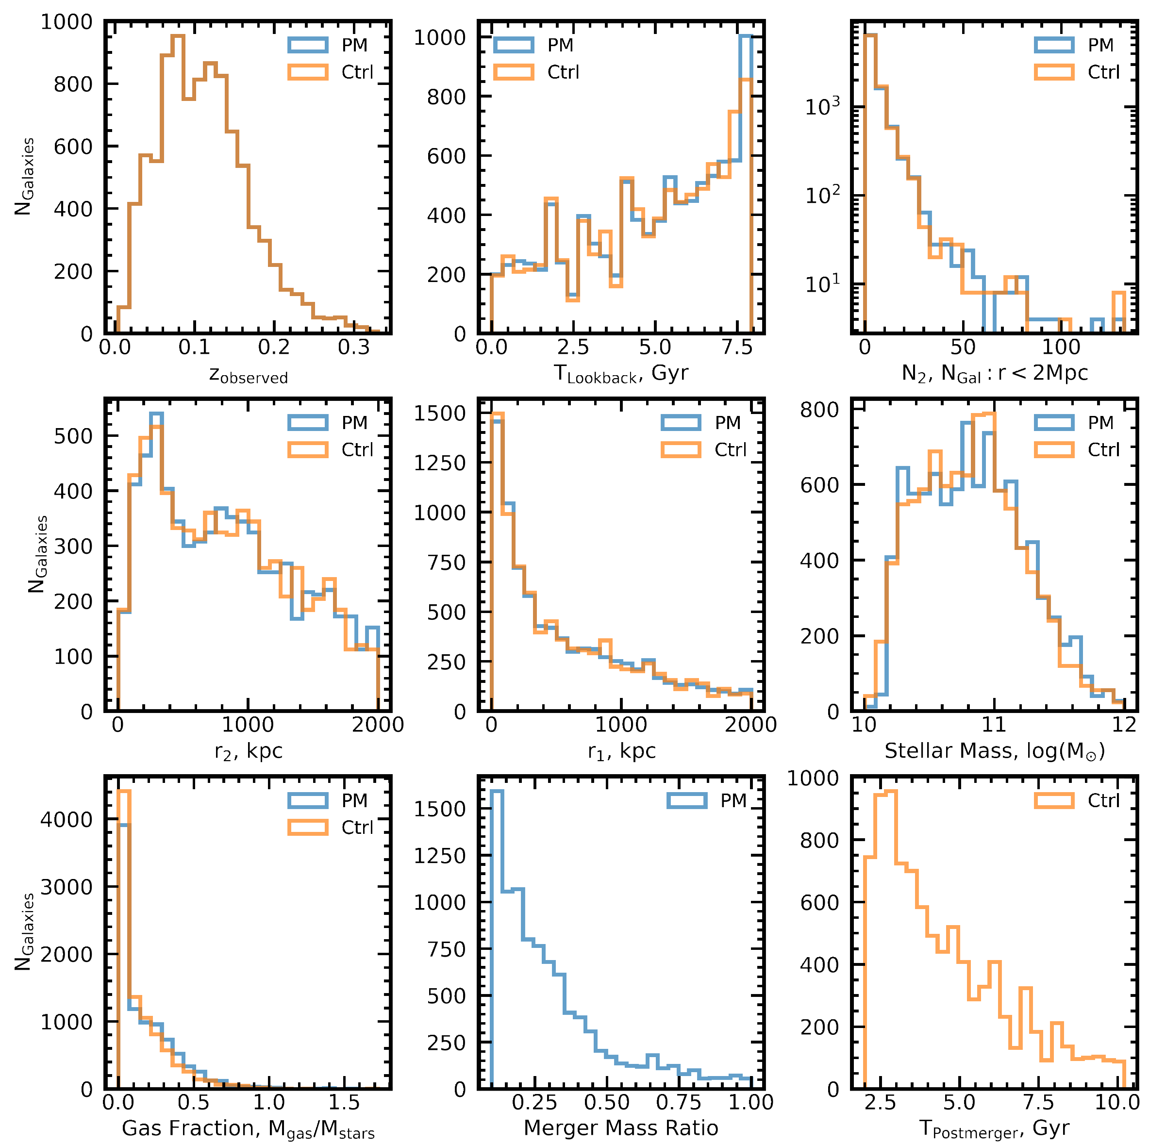
Galaxy Samples
Post-mergers
Merged at $z_{simulation}<1.0$, mass ratio > 0.1 .
$M_{∗}∈\left[{10}^{10}, {10}^{12}\right] M_{⊙}$.
2332 selected (x4 camera angles, x4 random redshifts).
Control sample
Not merged in 2 Gyr.
Matched with post-mergers by $M_{∗}$, $z_{simulation}$, $r_{1}$, $r_{2}$ (distance to nearest and second-nearest neighbors), $N_{2}$ (no. of neighbors in 2Mpc).
Two sample are perfectly balanced.

Slide 6
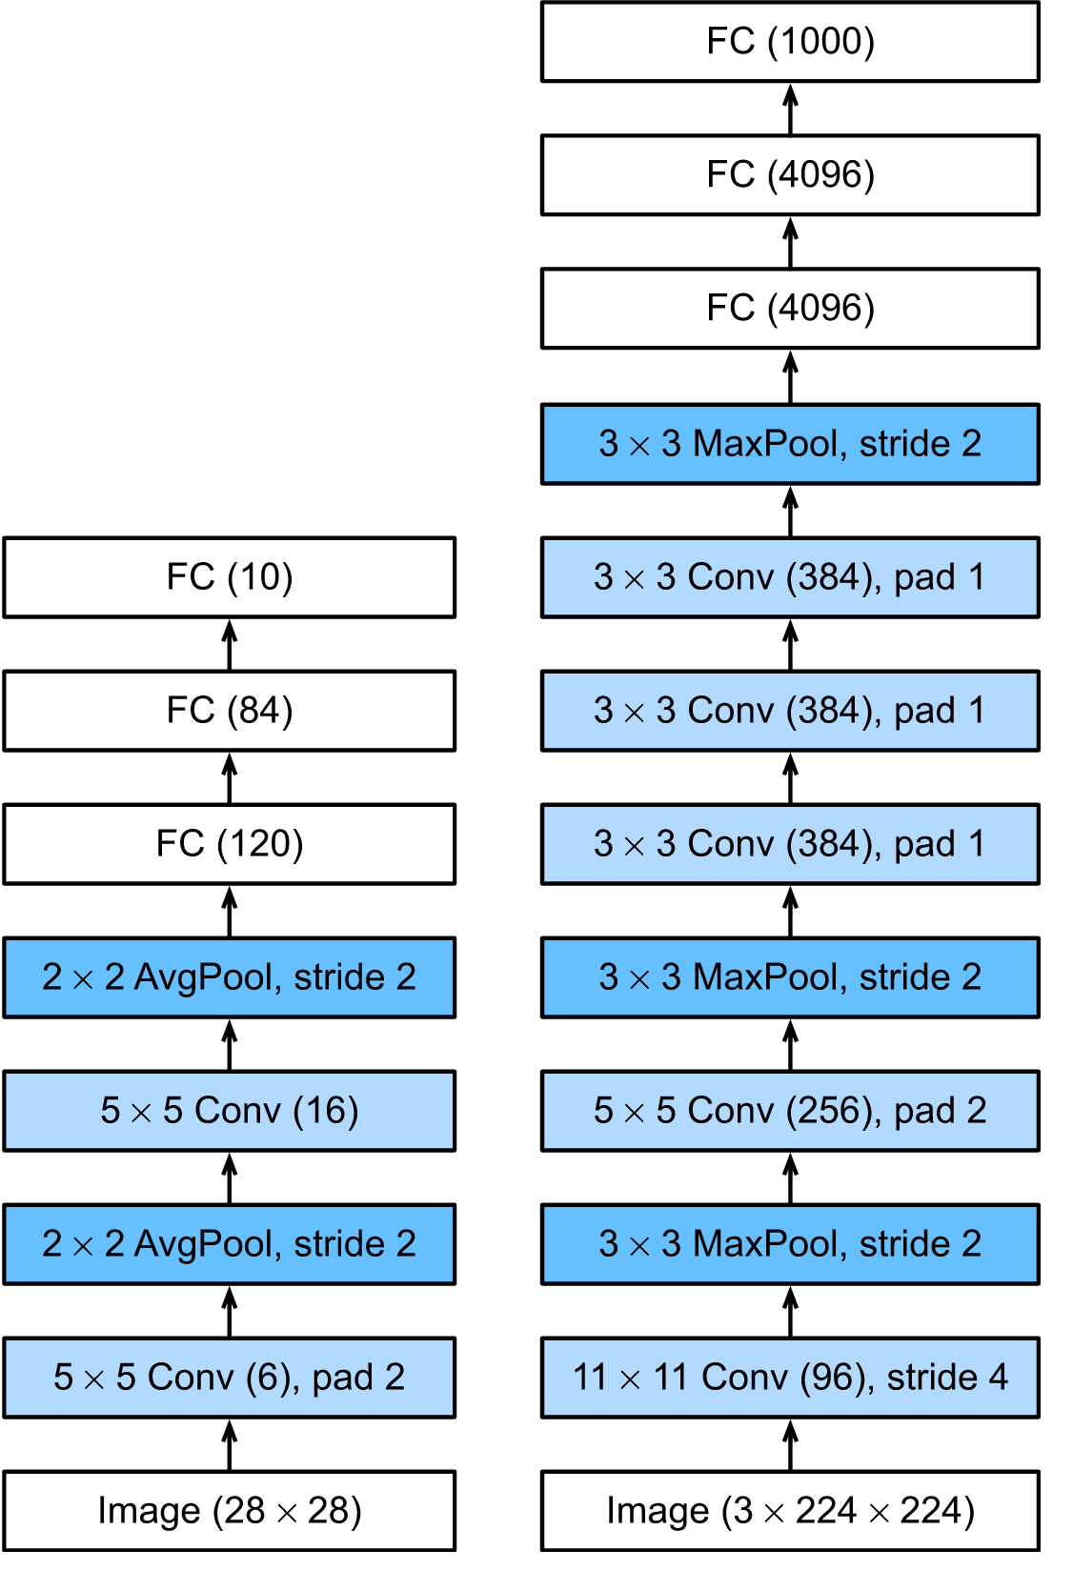
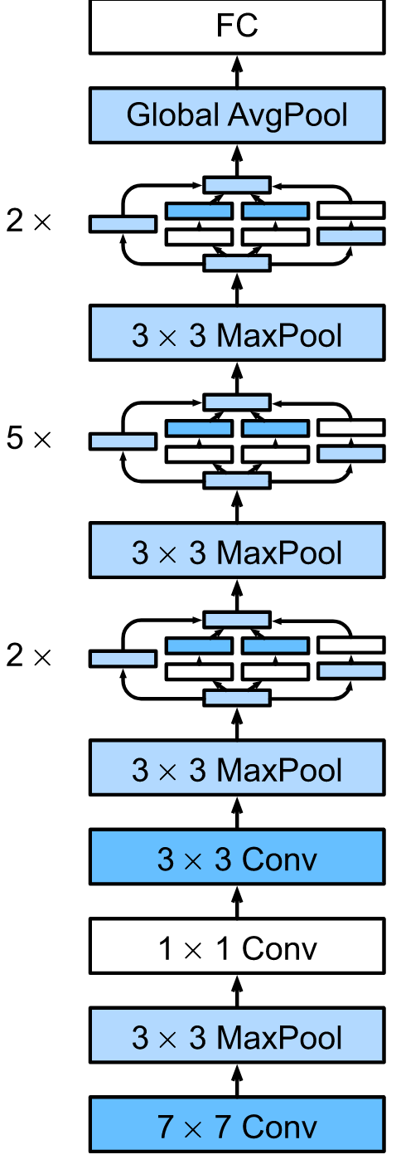
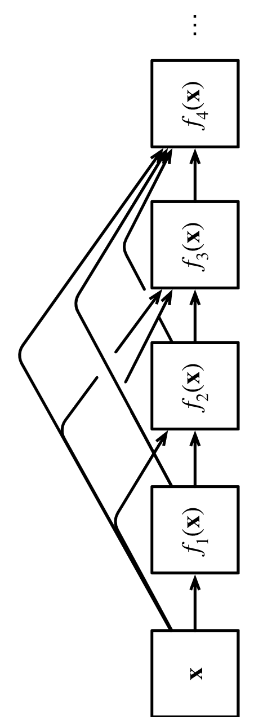
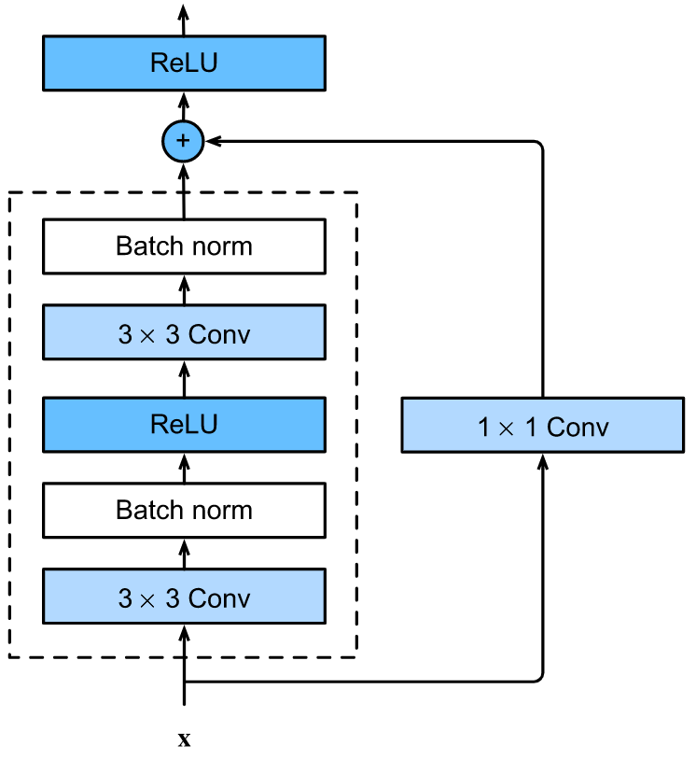
Figures from https://d2l.ai/
LeNet (1989)
Convolution layer
Sigmoid activation
Gradient back propagation
7 layers.
ResNet (2015)
Blocks with shortcuts.
VGG Net (2014)
Abstract design
Small kernel + deep network
>= 11 layers
NiN Net (2013)
K=1 kernels
Global Average pool
DenseNet (2017)
Densely connected.
AlexNet (2012)
ReLU Activation
Max pooling
Image augmentation
11 layers
GoogLeNet (2014)
Inception blocks
Stivaktakis+ 2018 (spec-z)
Bickley +2021 (This paper)
Moster+ 2020 (GalaxyNet)
Wells+ 2020 (U-Net)
Sanchez+ 2018
(Morphology classification)
Green+ 2020 (Stellar Model)
Bernardini+ 2019 (U-Net)

Slide 7
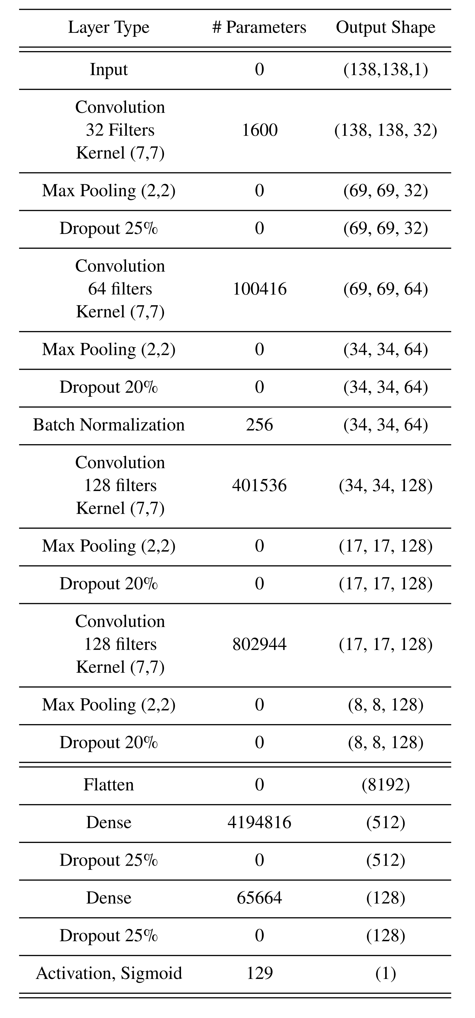
The CNN Architecture
Similar to the AlexNet (2012)
CNN layers:
Kernel size
Stride
Padding
Pooling
Activation
Optimization techniques:
Normalization on the input
On-the-fly augmentation
Random dropout
Batch Normalization

Slide 8
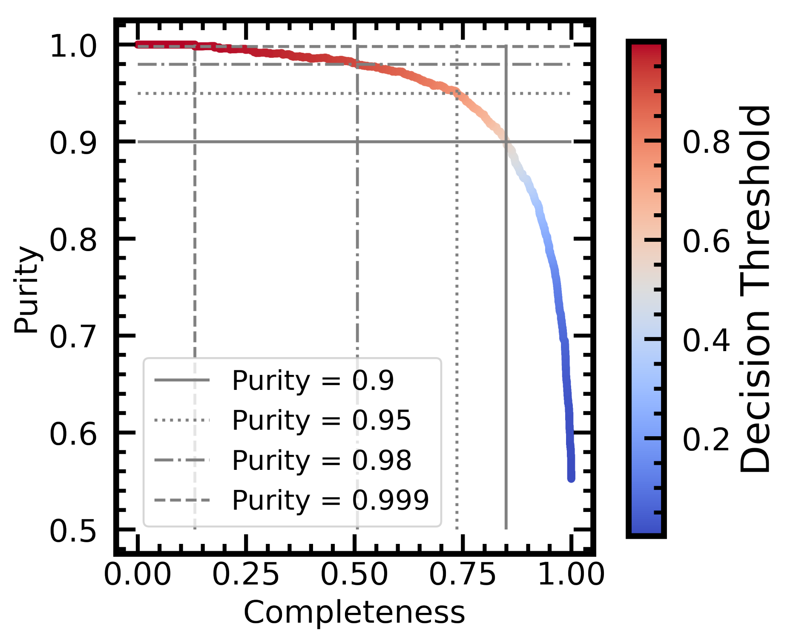
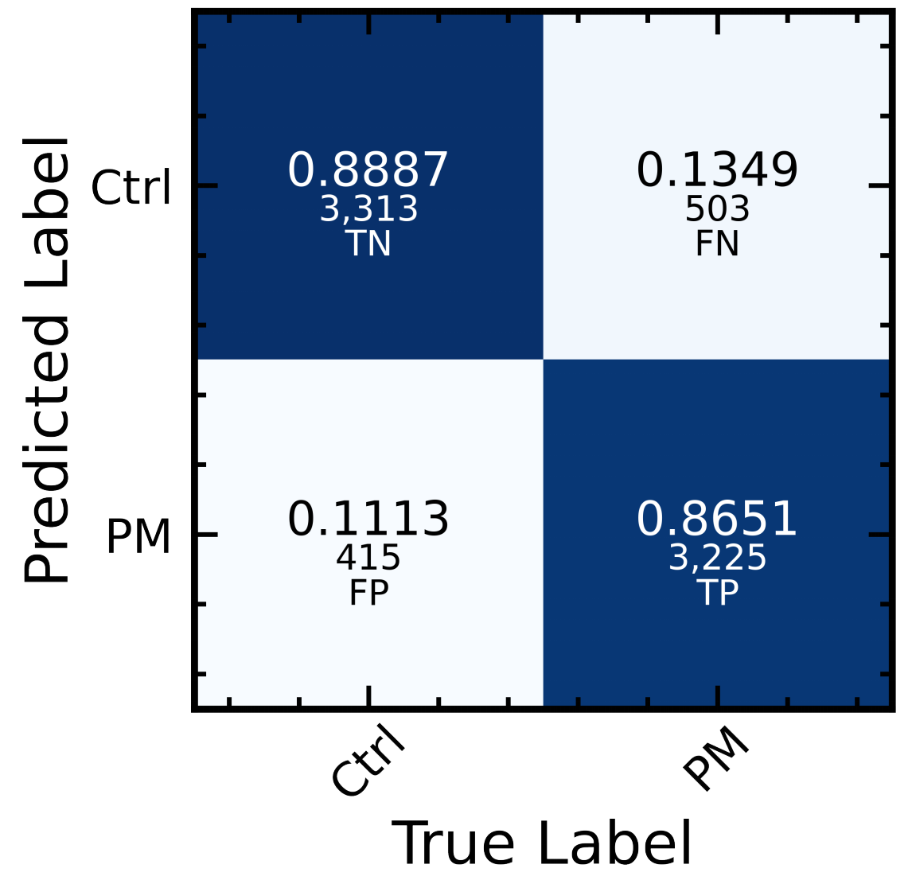
Performance Evaluated on the Balanced Test Dataset
Confusion Matrix

Slide 9
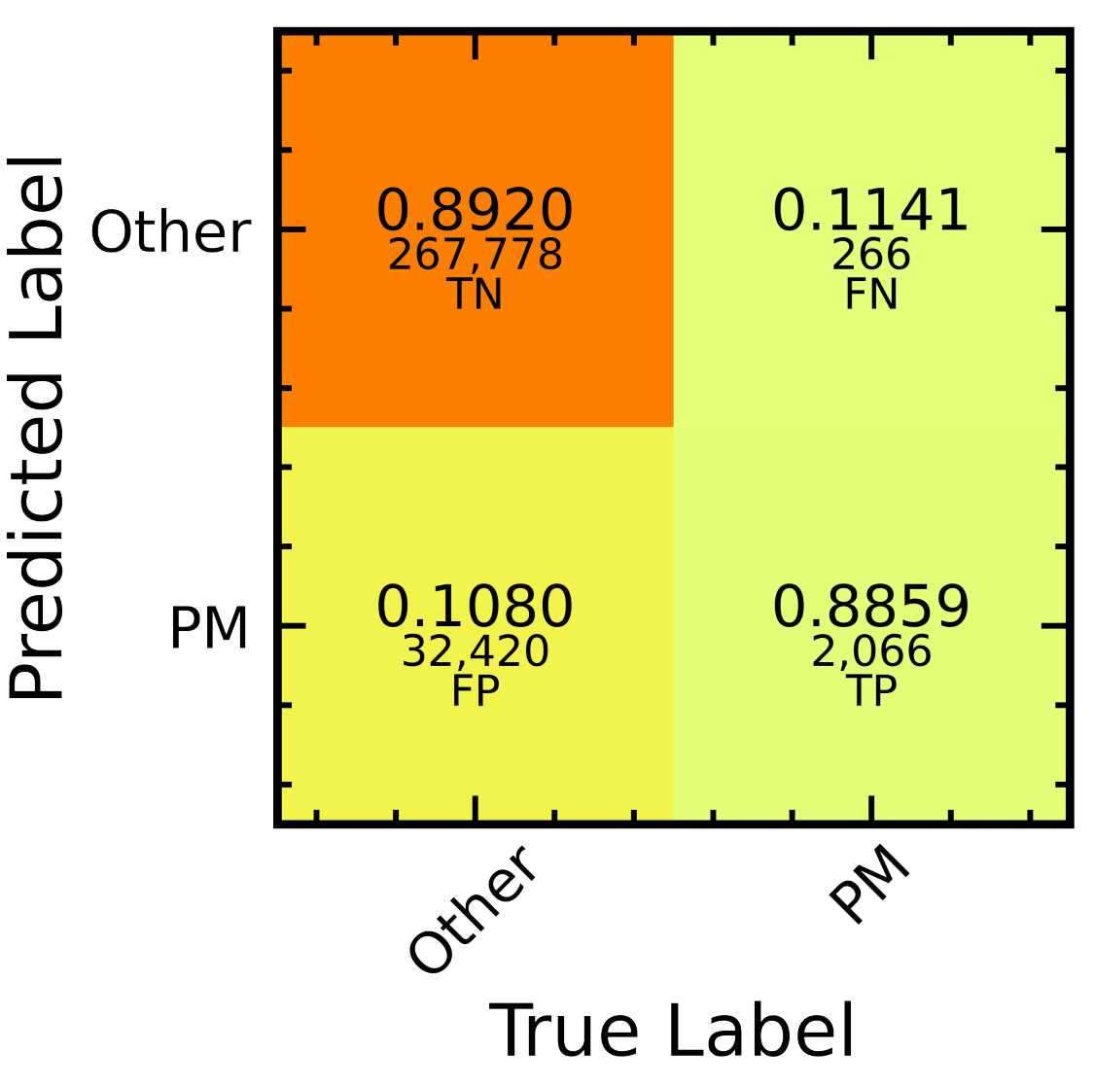
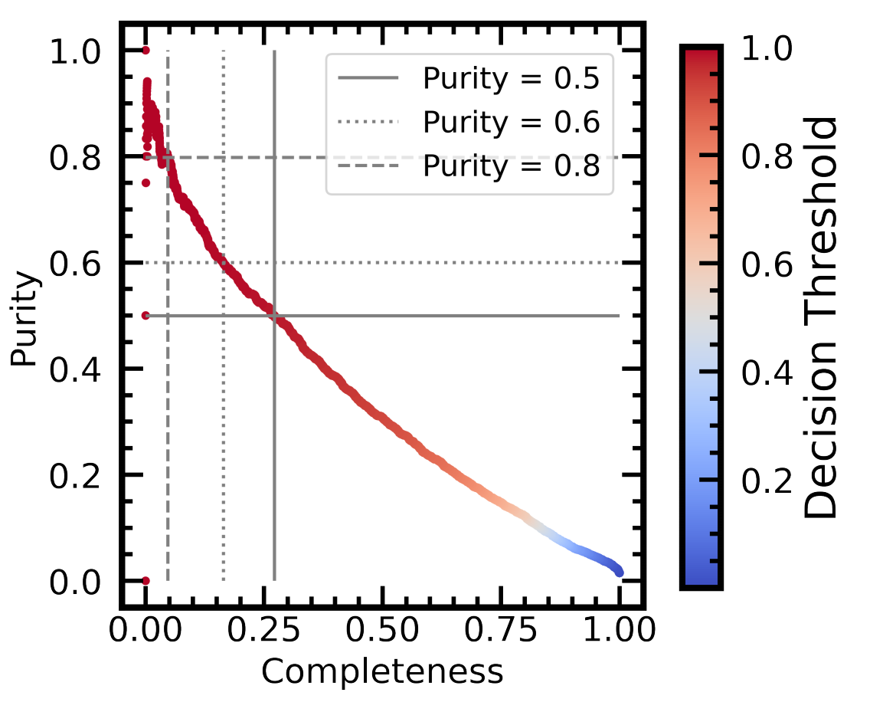
Performance Evaluated on the Mock Surveys
Sample imbalance is the key source of the false-positive cases.
A trade-off between purity and completeness should be made in the real application.
Performance on the Balanced Test Dataset
Performance on the mock survey images
(not balanced)

Slide 10
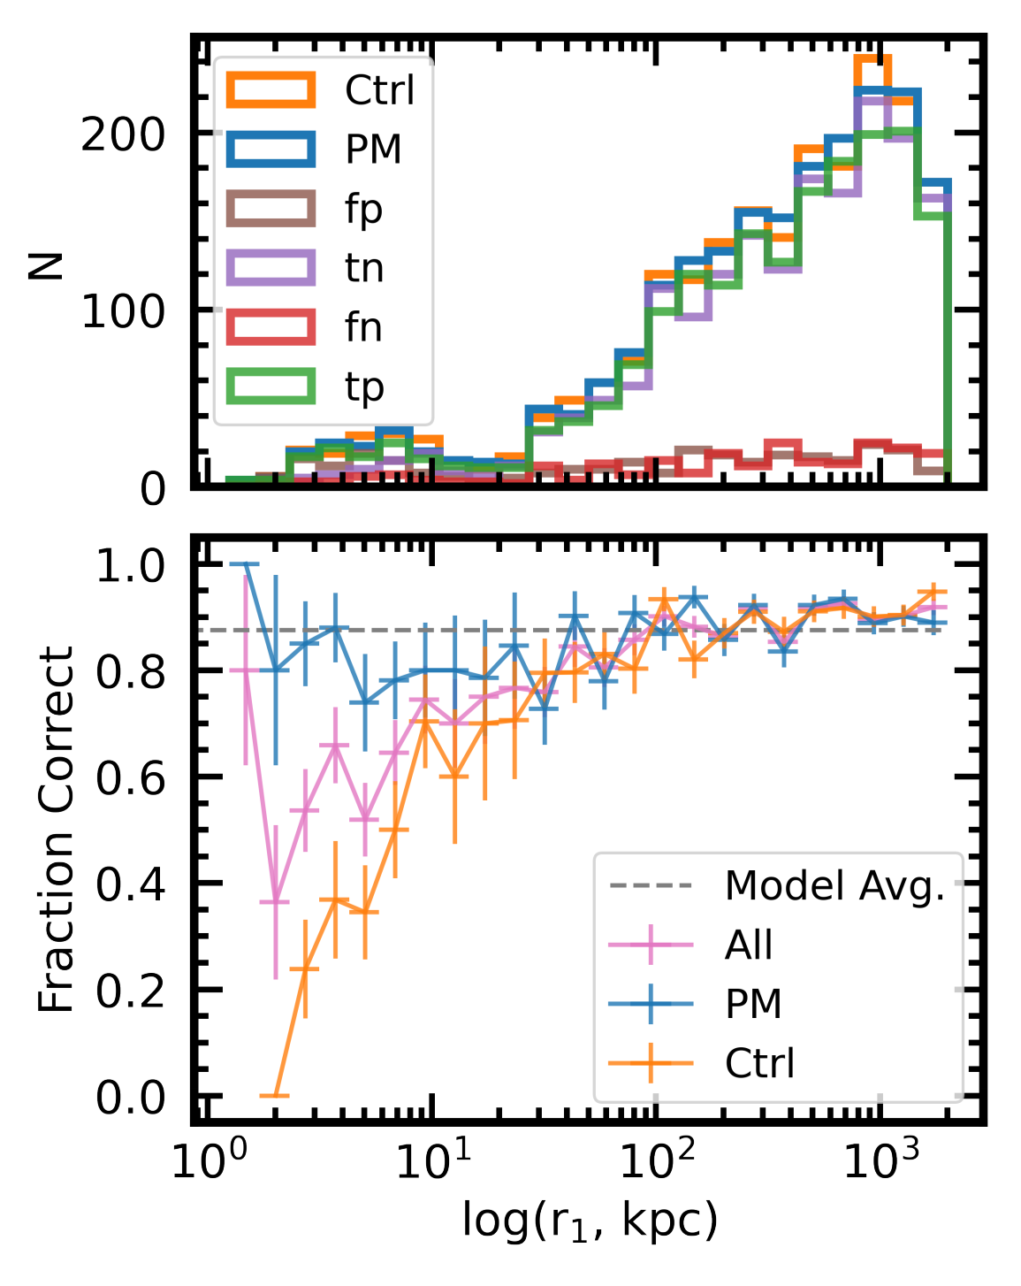
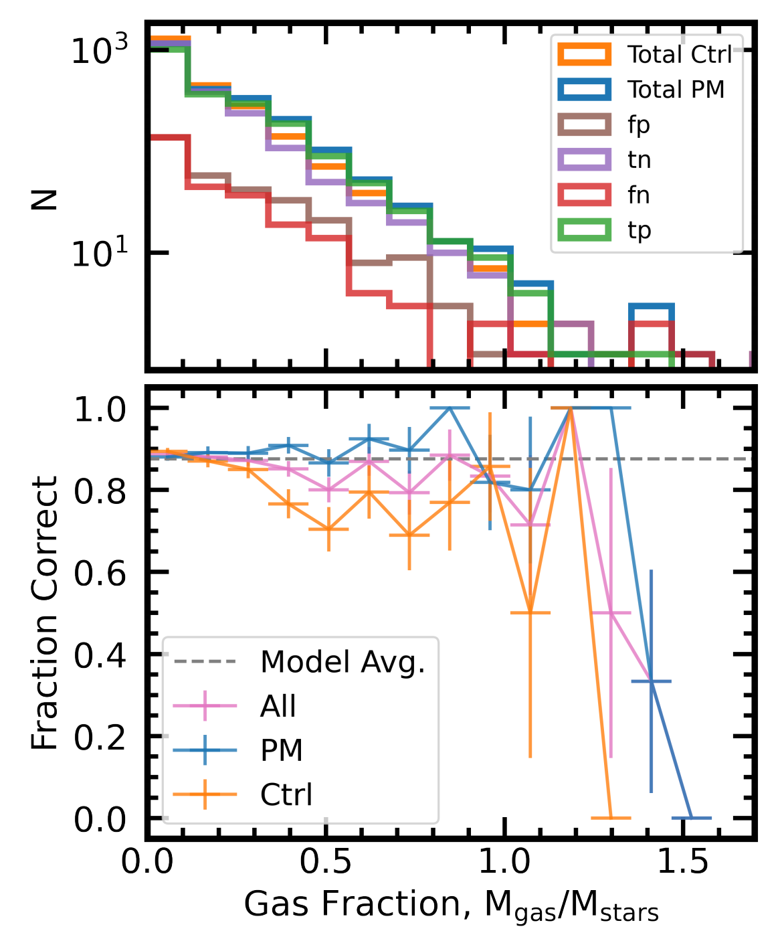
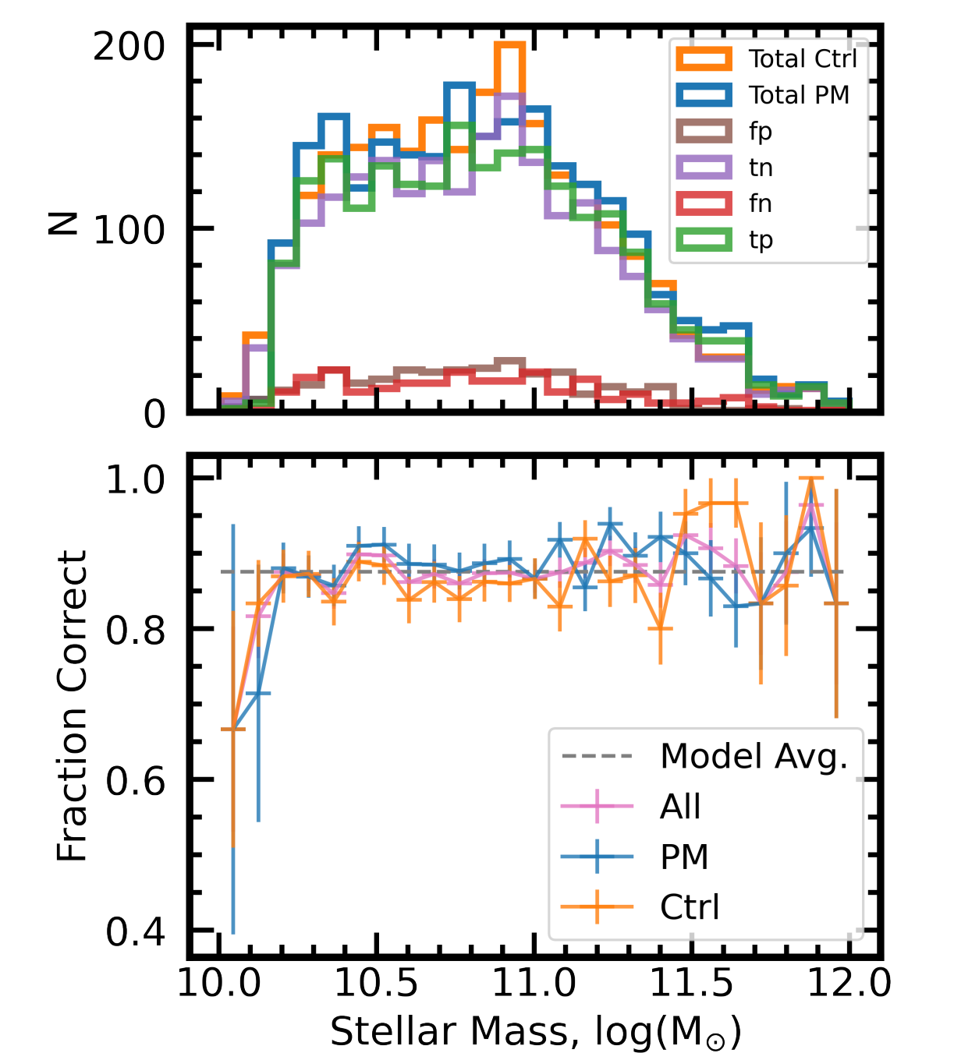
Test Performance vs. Galaxy Properties
Test performance depends on environment - a close companion introduces merger-like features, which gives the false-positive classification.
Low $M_{∗}$ galaxies with higher gas fraction have worse performance due to limited size of training sample.
Performance is not correlated with other quantities ($z_{obs}$, merger mass ratio, ...).

Slide 11
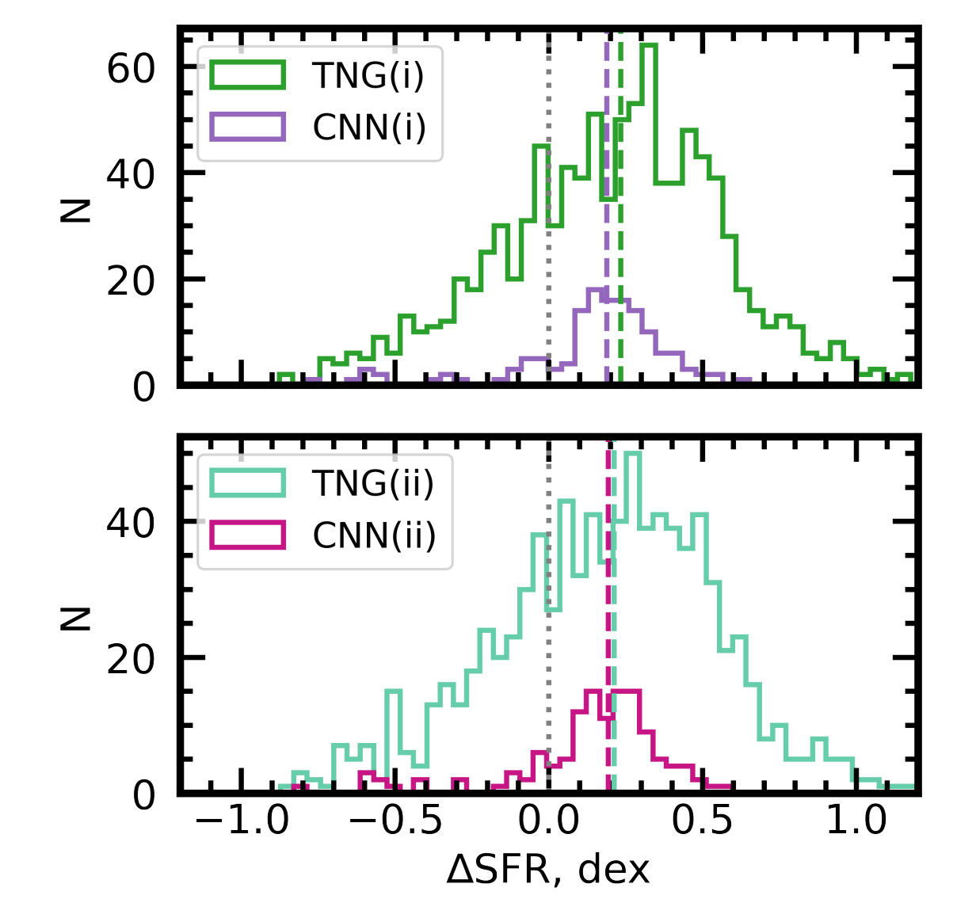
Star-formation Enhancement
in the Post-mergers
Strategy: use extreme classification threshold to purify the prediction (0.999 for post-mergers, 0.001 for controls)
Result: the star-formation enhancement is recovered.
Possible limitations: other statistics is likely biased due to sample incompleteness.

Slide 12
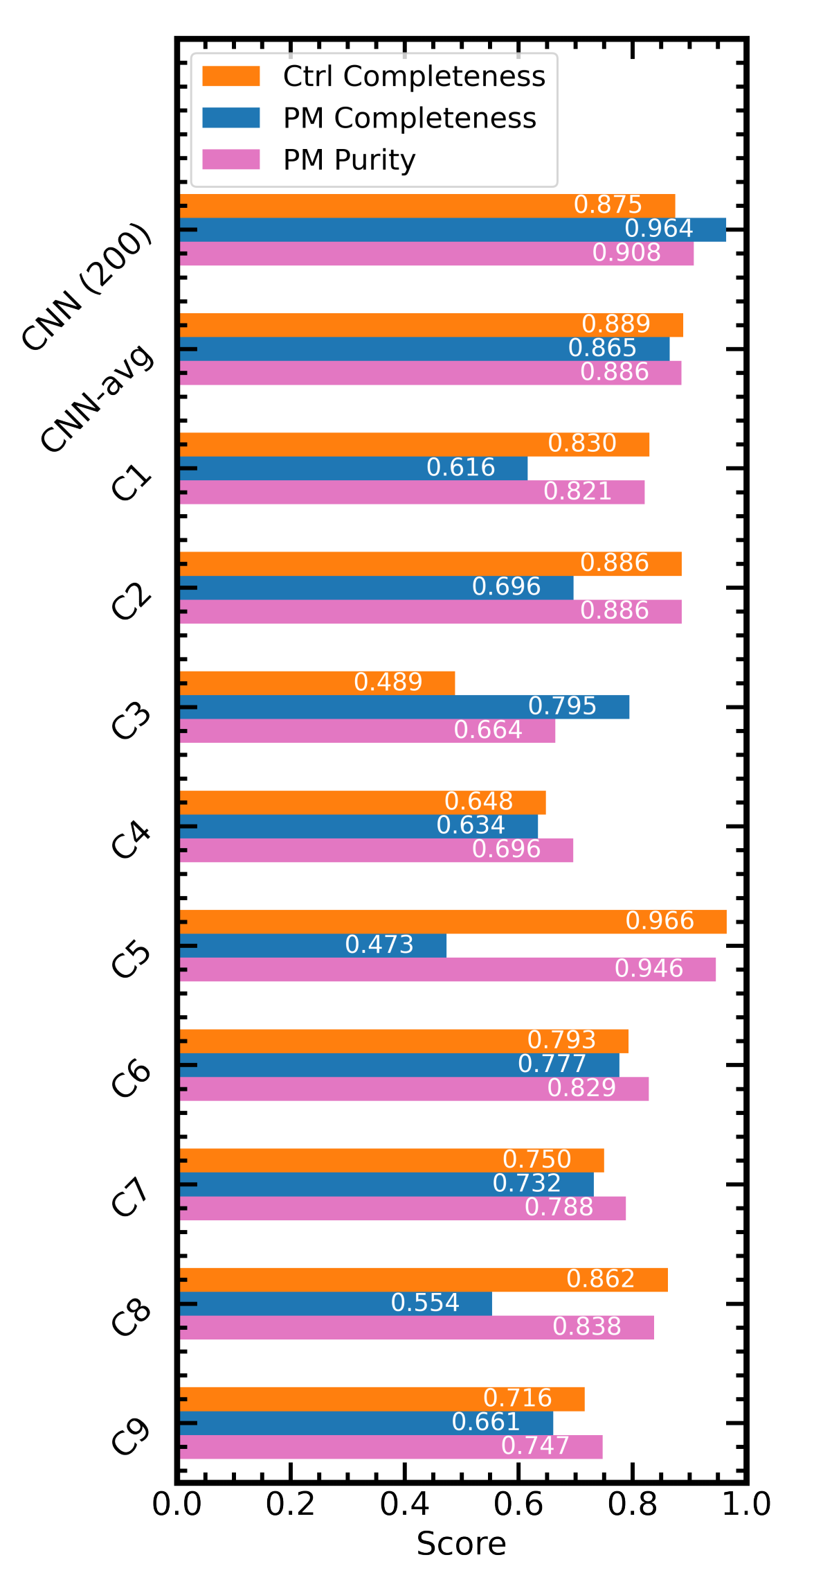
This work
Comparison with Visual Classification
Three Astronomy Faculty
Members
CNN has the best post-merger completeness, but a trained person may have better purity.
A hybrid approach will be used in identifying the post-merger galaxies in real CFIS images.
Two astronomy
post-doc
Two astronomy
graduate student
An astronomy
undergraduate student
A mechanical engineer

Slide 13
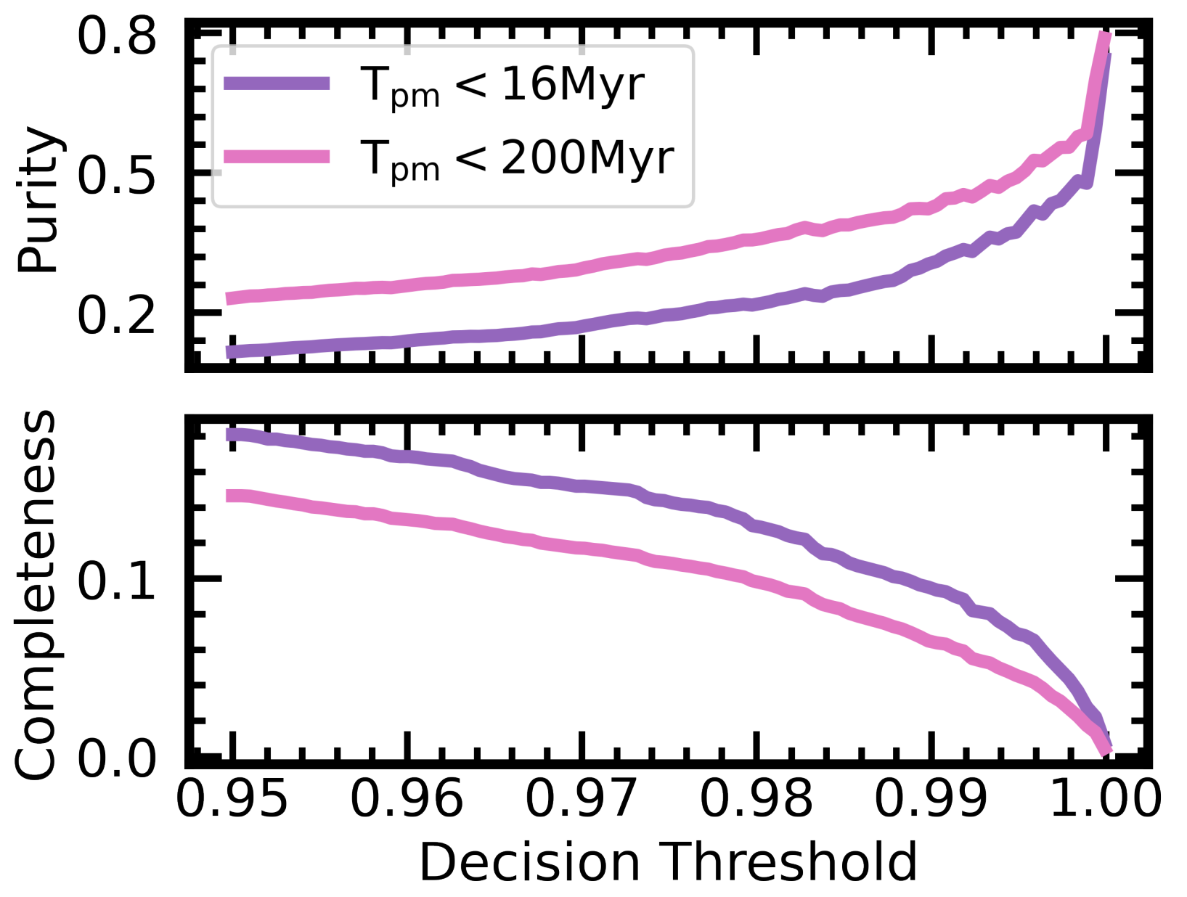
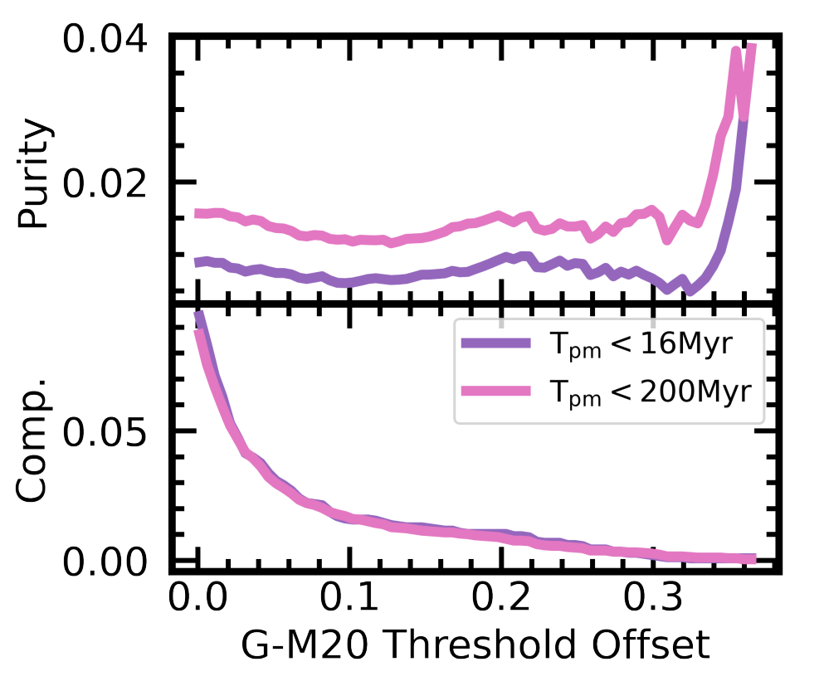
Comparison with Other Automated Methods
CNN has significantly better purity and completeness.
G-M20 method never reaches ~ 0.8 purity.
CNN is able to capture signals at different scales.
CNN (this work)
Using M20 + Gini Index (Lotz+ 2008)

Slide 14
Summary of arXiv:2103.09367
CNN models in image classification:
Prepare training data from hydrodynamical simulations.
Pick a proper model from the CNN zoo.
Pay attention to the sample imbalance.
Real performances depends on the completeness-purity trade-off.
Comparison with other methods:
CNN outperforms manually designed features like Gini+M20.
The hybrid of CNN and visual identification is likely to achieve the best performance.

